Slide 1
A Framework on Sentiment Analysis Based upon Product Reviews Using Neural Network
Notes:
1
10/19/2019

Slide 2
Contents
Introduction
Motivation
Objectives
Literature Survey
Challenges
Methodology
Implementation
Performance Analysis
Limitations
Conclusion
Future Recommendations
References
Notes:
1

Slide 3
Introduction
Sentiment Analysis
- Computational approach to identify and categorize opinions of content
Multiclass Classification
Problem of classifying instances into one of the more than two classes
Necessity of Sentiment analysis of Product Reviews
- 84% people give product reviews as much importance as personal recommendation [1]
Notes:
1

Slide 4
Motivation
The majority of current approaches aim to detect the overall polarity in various classes without having proper accurate results.
To provide information about different aspects of the product at a glance
Time consuming, error prone and costly manual process
Notes:
1

Slide 5
Objectives
To classify sentiment in three classes using neural network.
To detect sentiment for different aspects of a product from product reviews.
To achieve more than 80% accuracy after total analysis.

Slide 6
Literature Survey
[2]Using Machine Learning Approach ( Wang et al. , 2012)
- Sentiment classification using Naive-Bayes strategy
- Classifies tweets in four classes: positive, negative, neutral and unsure
Limitations
- Requires large volume of human annotated data
- Correlation of the words are ignored
Notes:
1

Slide 7
Literature Survey (Cont.)
[3]Using Dictionary Based Approach ( Singh et al. , 2013)
- Sentiment classification system for movie reviews
- Uses adverb and adjectives to calculate the sentiment score
Limitations
- Algorithm only does binary classification of sentiment
- Does not provide aspect based ratings
Notes:
1

Slide 8
Literature Survey (Cont.)
[4]Using Corpus Based Approach ( Akter et al. 2017)
- Developed method works for both Bangla and English languages
- Solves the problem of finding opinion words with context specific orientations
Limitations
- Individual corpus for every product needs to be created
- Algorithm only does binary classification of sentiment
Notes:
1

Slide 9
Challenges
Finding a large dataset for analysis
A well-developed hardware system for building the neural network system
Time consuming
Notes:
1

Slide 10
Methodology
Notes:
1

Slide 11

Methodology (Cont.)
Data Collection: Dataset was collected from Amazon API.
Figure 1: Block diagram of Data Collection
Data Pre-processing: Data pre-processing means to process the data into concept based sequential text array for further processing.
Notes:
1

Slide 12
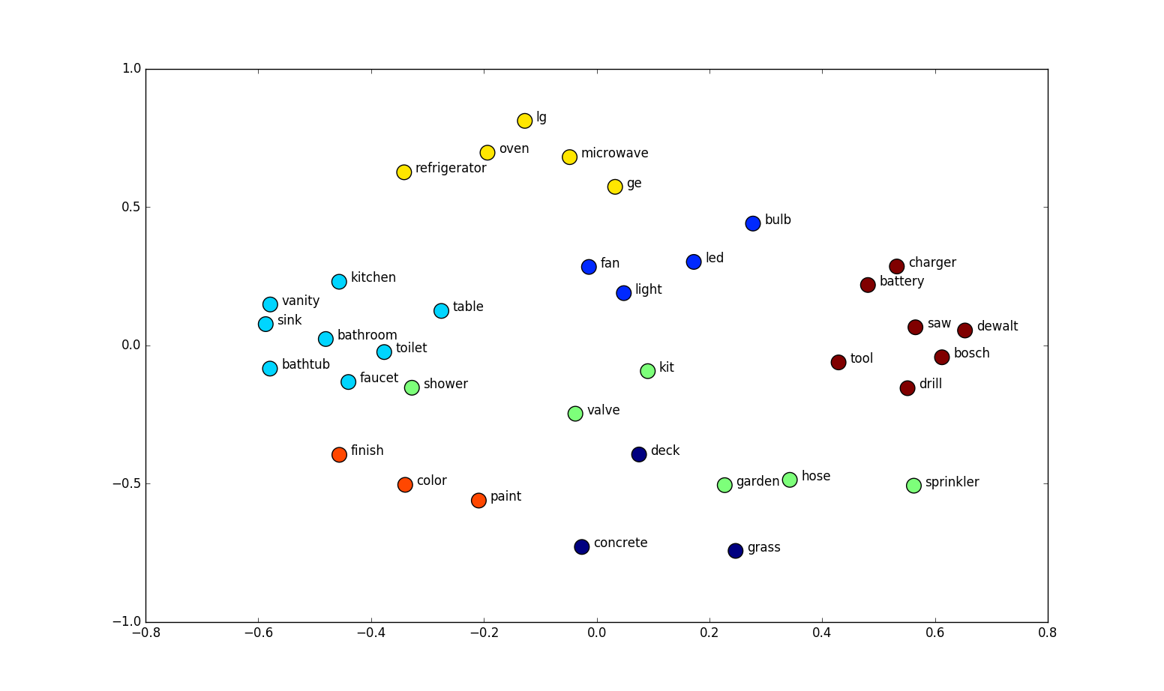
Methodology (Cont.)
Sequence Generation: Tokenized words have been converted into conceptbased vectors.
Figure 2: Clustering the tokens.

Slide 13
Methodology (Cont.)
Categorization: When we used text to sequence classifier, the tokenized words were divided into various clusters. Each clusters are represented here as a distinct category.
Building Neural Network Model: Multistep multichannel neural network has been built where every channel consists of six individual hidden layers.
Input Layer
Embedding Layer
Bidirectional LSTM Layer
Conv1D Layer

Slide 14
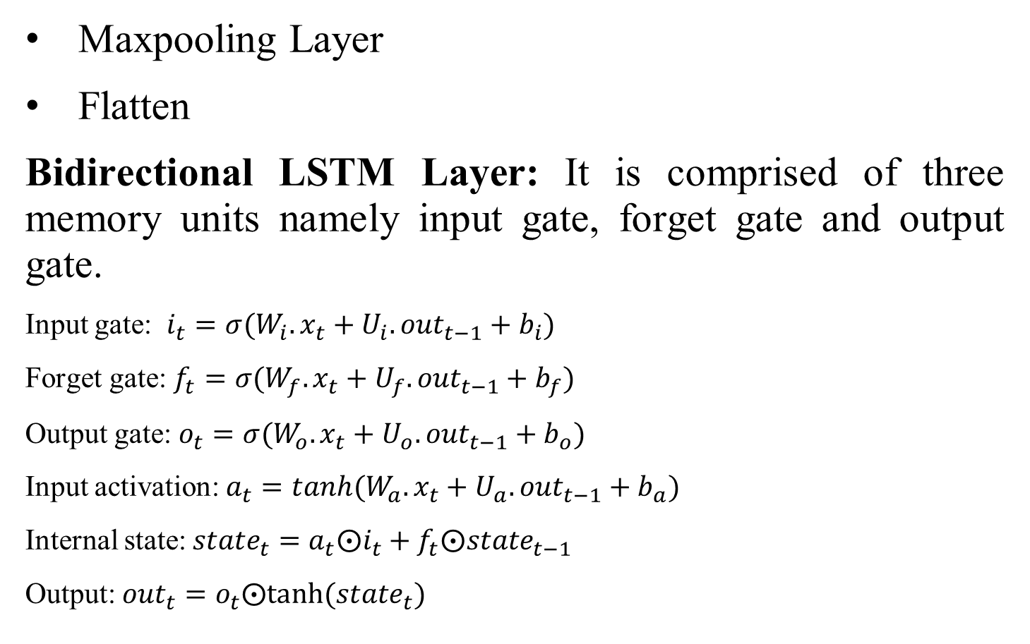
Methodology (Cont.)

Slide 15
Methodology (Cont.)
Concatenation: From the previous three step channels, we derived three single dimensional data arrays which have been concatenated into one array for sending it to output layer.
Evaluation: Here, the model is evaluated using test data and the accuracy has been calculated.
Sentiment with aspect: This is the visible output section where the polarity of the input sentence is predicted with corresponding aspects.

Slide 16
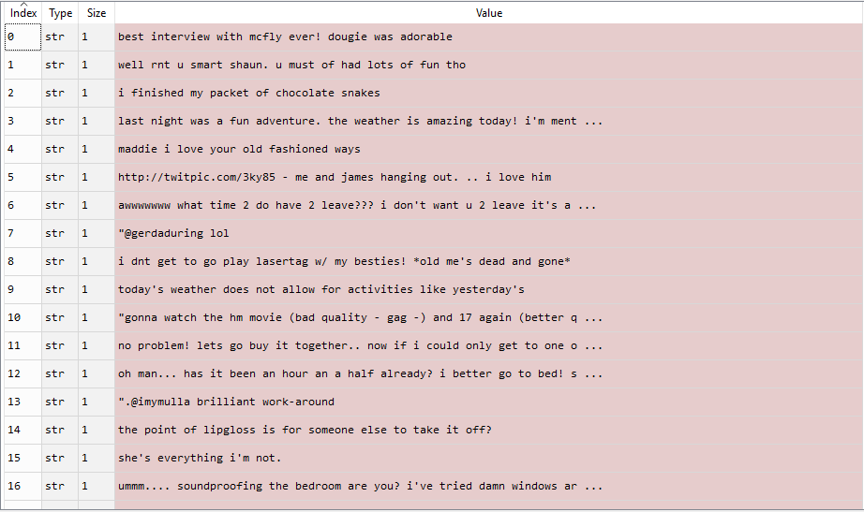
Implementation
Dataset: Our dataset contains data of two parameters. Sentence and label of polarity.
Figure 3: Dataset

Slide 17
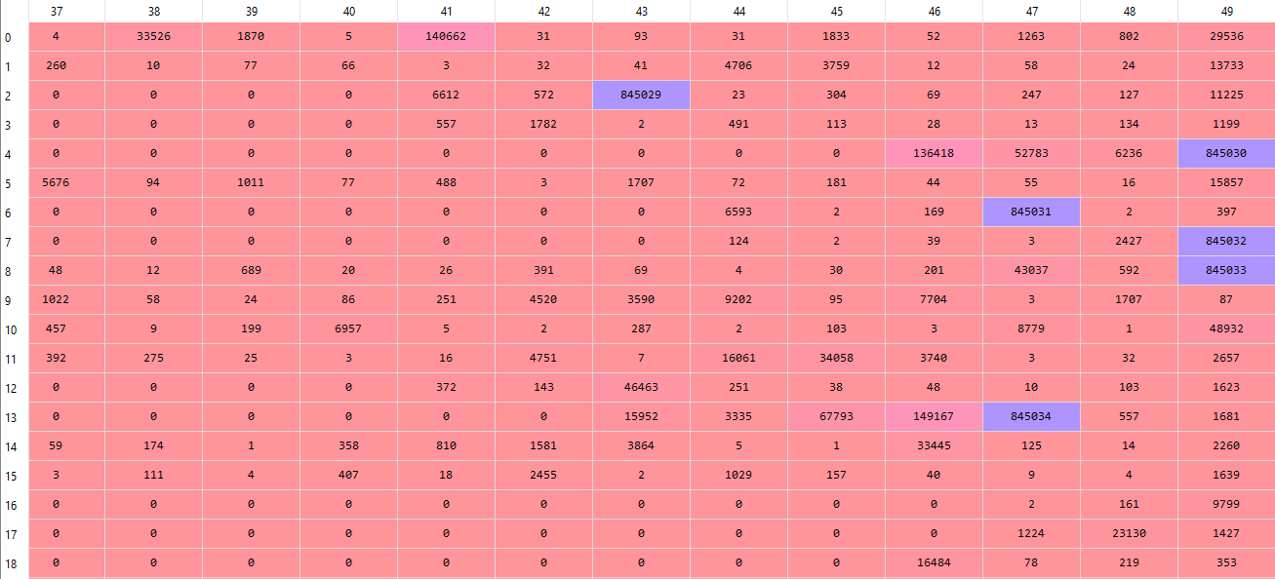
Implementation(Contd.)
Text to Sequence Conversion:
Figure 4: Text to Sequence Conversion

Slide 18
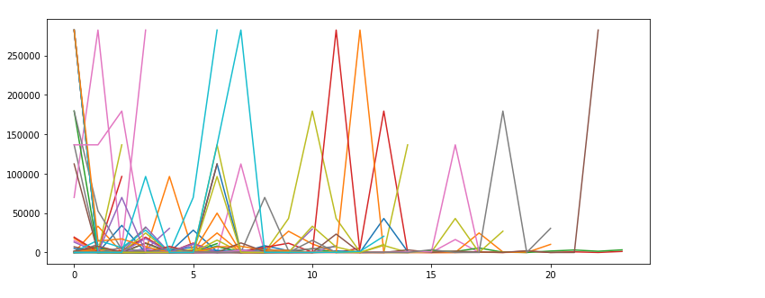
Implementation(Contd.)
Sequence Graph:
Figure 5: Sequence Graph

Slide 19
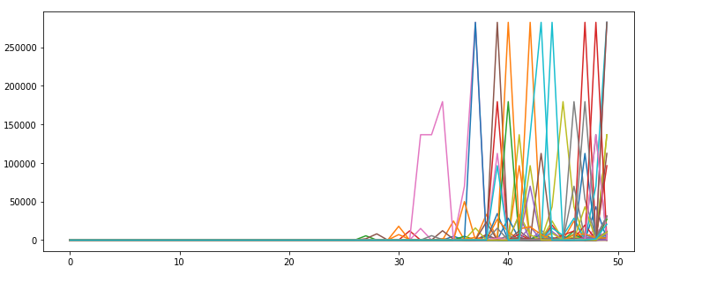
Experimental Results
Padding Sequence:
Figure 6: Padding Sequence

Slide 20
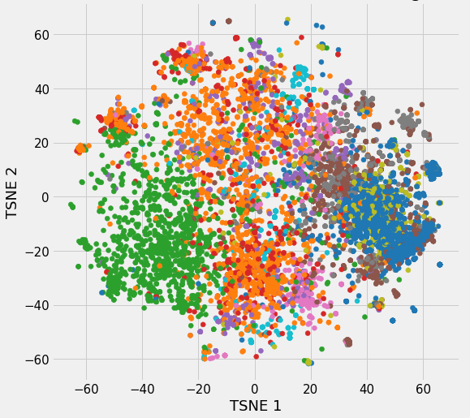
Implementation(Contd.)
Embedding Sequence:
Figure 7: Embedding Sequence

Slide 21
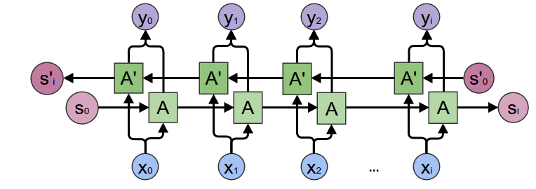
Implementation(Contd.)
Bi-directional LSTM layer:
Figure 8: Bi-directional LSTM layer

Slide 22
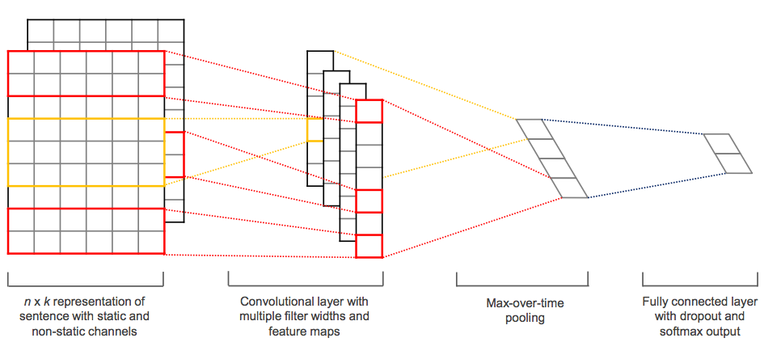
Implementation(Contd.)
Conv1D with Maxpooling:
Figure 9:Conv1D with Maxpooling

Slide 23
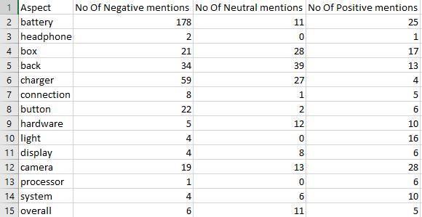
Performance Analysis
Sentiment Classification Results: The calculated result is given below:
Figure 10: Calculated Sentiment with Multiple Aspects

Slide 24
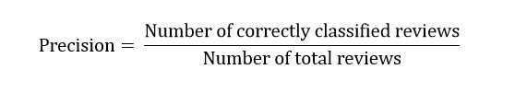
Performance Analysis(Contd.)
Method | Accuracy
Multi Step Convolution1D | 83.46%
Single Step ConvLSTM | 89.56%
SVM | 82.4%
Proposed Method(Multi Step ConvLSTM) | 93.11%
Figure 11: Comparison among various methods

Slide 25
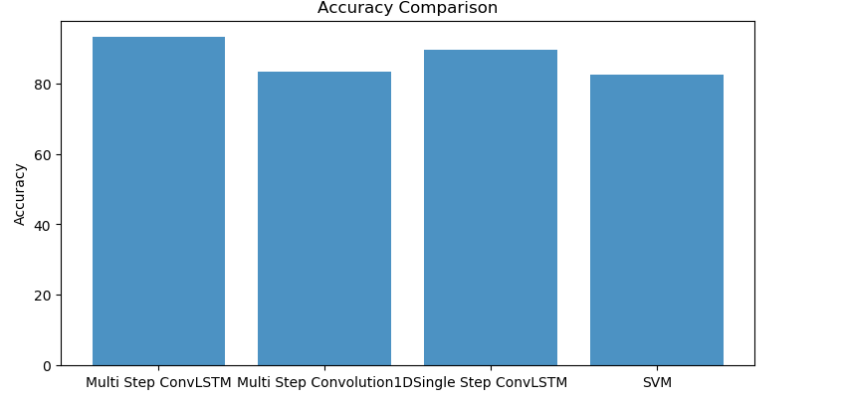
Performance Analysis(Contd.)
Graphical Representation:
Figure 12: Comparison graph among different methods

Slide 26
Limitation
This model can analyze 78 language’s sentiments. If the model is developed more, it can analyze more languages
Due to lack of a well-developed dataset, aspect detection wasn’t up to a satisfactory level.
This hybrid model is a bit complex compared to others. It can work well with a large dataset, but for small dataset, other models are comparatively better.
Notes:
1

Slide 27
Conclusion
System can classify reviews in three classes
System can detect different aspects of the product
We have conducted tests to evaluate the system
System performance is in an acceptable range
Notes:
1

Slide 28
Future Recommendations
Classifying larger dataset manually to compare with calculated output.
Further analysis on sentiment classification algorithm for better accuracy
Automated aspect selection would be a huge improvement.
Notes:
1

Slide 29
References
[1] BrightLocal Local Consumer Review Survey 2016 available at https://www.brightlocal.com/learn/local-consumer-review-survey Last Accessed 7 January 2017.
[2] H. Wang, D. Can, A. Kazemzadeh, F. Bar, and S. Narayanan, “A system for real-time twitter sentiment analysis of 2012 U.S. presidential election cycle” in Proc. of the Association for Computational Linguistics 2012 System Demonstrations, 2012, pp. 115-120.
[3] V. K. Singh, R. Piryani, A. Uddin, P. Waila, “Sentiment Analysis of Movie Reviews, A new Featurebased Heuristic for Aspect-level Sentiment Classification”, in Automation, Computing, Communication, Control and Compressed Sensing (iMac4s), International Multi-Conference, 2013, pp. 712-717. [4] S. Akter and M. S. Arefin, “Developing a Method for Sentiment Analysis from the Document of Two Languages”, 2017.
Notes:
1

Slide 30
References (Cont.)
[5] K. Toutanova, D. Klein, C. Manning, and Y. Singer, “Feature-Rich Part-of-Speech Tagging with a Cyclic Dependency Network” In Proc. of HLT-NAACL 2003, pp. 252-259.
[6] SentiWordNet 3.0, available at http://www.sentiwordnet.isti.cnr.it Last Accessed 10 September, 2017.
[7] P. Gamallo and M. Garcia, “Citius: A Naive-Bayes Strategy for Sentiment Analysis on English Tweets” Proc. 8th International Workshop on Semantic Evaluation (SemEval 2014), Dublin, Ireland, August 23-24, 2014, pp. 171-175.
[8] F. Benamara, C. Cesarano, A. Picariello, D. Reforgiato, V. S. Subrahmanian, “Sentiment Analysis: Adjectives and Adverbs are better than Adjectives Alone”, in Proc. ICWSM 2006, CO USA, 2006. [9] I. G. Councill, R. McDonald, L. Velikovich, “What’s Great and What’s Not: Learning to Classify the Scope of Negation for Improved Sentiment Analysis”, in Proc. of the Workshop on Negation and Speculation in Natural Language Processing ,Uppsala, July 2010, pp. 51–59.
Notes:
<number>

Slide 31
Thank You
Notes:
<number>

